Slide 1
Software Quality Engineering
Lecture 1
Part III-software Inspection
alina.arshad@nu.edu.pk

Slide 2
Reviews
A group of people carefully examine part or all of a software system and its associated documentation.
Purpose: to find defects (errors) before they are passed on to another software engineering activity or released to the customer.

Slide 3
(Informal) Reviews
Why make informal reviews?
Everyone makes mistakes
Create open atmosphere (increase productivity)
Programming is a social activity (or should be)
Find errors in program early (before it is run the first time)
Find quality issues
Improve programming skills of all involved
Anything can be reviewed
(. . . , use cases, documentation, . . . )

Slide 4
How to hold a Review meeting?
Purpose: to evaluate a software product to:
determine its suitability for its intended use
identify discrepancies from specifications & standards
Participants read documents in advance
then bring their comments to a meeting for discussion
A review:
may provide recommendations and suggest alternatives
may be held at any time during a project
need not reach conclusions on all points

Slide 5
Review meeting - What to avoid?
Improvements to the program
Blaming programmers
Finger pointing

Slide 6
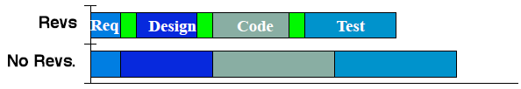
Why Review? If we already test!
Reviews improve schedule performance.
Reviews reduce rework.
Rework accounts for 44% of dev. cost!
Reqs (1%), Design (12%), Coding (12%), Testing (19%)
Reviews are pro-active tests.
Find errors not possible through testing.
Reviews are training.
Domain, corporate standards, group

Slide 7
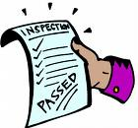
What is an Inspection?
Inspection in software engineering, refers to peer review of any work product by trained individuals who look for defects using a well-defined process. An inspection might also be referred to as a Fagan inspection after Michael Fagan, the inventor of the process.

Slide 8
Software Inspection
Most commonly performed software quality assurance (QA) activity besides testing.
Inspection directly detects and corrects software problems without resorting to execution, therefore it can be applied to many types of software artifacts.
As a result of this direct examination, the detected software defects are typically precisely located, and therefore can be fixed easily in the follow-up activities.

Slide 9
Inspection Purposes
Primary Purpose
Identify potential defects during preparation and validate them at the meeting.
Validate the fact that identified items are actual defects.
Record the existence of the defect.
Provide the record to the developer to use in making fixes.

Slide 10
Inspection Purposes
Secondary Purpose
To increase programming quality
To achieve lower life cycle cost
To provide traceability of requirements to design
To increase product quality at delivery etc.

Slide 11
How to Inspect?
Set an agenda and maintain it.
Limit debate and rebuttal.
Do not attempt to solve every problem noted.
Take written notes.
Insist on advance preparation.
Conduct meaningful training for all participants.
Inspect your earlier inspections.

Slide 12
Correction and follow-up
The discovered faults need to be corrected by people who are responsible for the specific software artifacts inspected. For example, in design or code inspection, the responsible designer or programmer, often labeled as design or code “owners” in industry, need to fix the design or code.
There should be some follow-up activities to verify the fix.

Slide 13
The case for inspection
The main difference between the object types of inspection and testing, namely executable programs for testing and all kinds of software artifacts for inspection,
The primary reason for the existence of inspection: One does not have to wait for the availability of executable programs before one can start performing inspection.
Basically, anything tangible can be inspected.

Slide 14
Inspection techniques
Wide variety of objects for inspection, so inspection techniques also vary considerably.
Inspection of product support plans must take into account the system configuration of the product in operation and its interaction with other products and the overall operational environment.
Consequently, different inspection techniques need to be selected to perform effective inspection on specific objects.

Slide 15
Degree of formality
Similarly, there are different degrees of formality, ranging from informal reviews and checks to very formal inspection techniques associated with precisely defined individual activities and exact steps to follow.
Even at the informal end, some general process or guidelines need to be followed so that some minimal level of consistency can be assured,

Slide 16
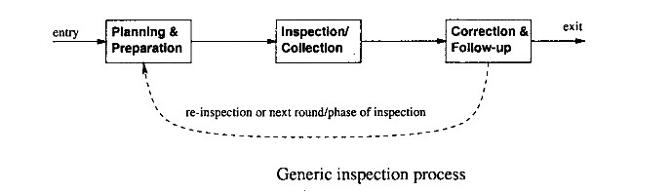
Generic inspection process

Slide 17
Planning and preparation
Inspection planning needs to answer the general questions about the inspection, including:
What are the objectives or goals of the inspection?
What are the software artifacts to be inspected or the objects of the inspection?
Who are performing the inspection?
Who else need to be involved, in what roles, and with what specific responsibilities?
What are the overall process, techniques, and follow-up activities of the inspection?

Slide 18
Inspection or collection
This step roughly corresponds to the execution of QA activities in generic quality engineering process.
The focus of this step is to detect faults in the software artifacts inspected, and record the inspection results so that these faults can be resolved in the next step.

Slide 19
Inspection Team Members
During an inspection the following roles are used:
Author: The person who created the work product being inspected.
Moderator: This is the leader of the inspection. The moderator plans the inspection and coordinates it.
Reader: The person reading through the documents, one item at a time. The other inspectors then point out defects.
Recorder/Scribe: The person that documents the defects that are found during the inspection.
Inspector: The person that examines the work product to identify possible defects.

Slide 20
Inspection Process (Cont..)
The stages in the inspections process are:
Planning
Overview meeting
Preparation
Inspection meeting
Rework and
Follow-up
The Preparation, Inspection meeting and Rework stages might be iterated.

Slide 21
(Formal) Inspections
An inspection might also be referred to as a Fagan inspection after Michael Fagan, the inventor of the process.
Structured review of software artifacts.
Competent and formally trained individuals investigate artifacts in order to:
Detect errors
Identify deviations from standards
Does not require execution of the system.

Slide 22
(Formal) Inspections
Examples of artifacts:
Design documents, requirements specifications, code, etc.
The inspection leader/organizer is not the author
leads the meeting
ensures all follow up actions are taken

Slide 23
FAGAN INSPECTION
The earliest and most influential work in software inspection is Fagan inspection (Fagan, 1976), which is almost synonymous with the term “inspection” itself.
Almost all the other inspection processes and techniques can be considered as derivatives of Fagan inspection, by enhancing, simplifying, or modifying it in various ways to fit specific application environment.

Slide 24
Inspection team
Fagan inspection typically involves about four people in the inspection team
The potential inspectors are identified in the planning stage (Step 1) from those designers, developers, testers, or other software professionals or managers, who are reasonably familiar with the software artifacts to be inspected, but not necessarily those who directly work on it.
An ideal mix would include people with different roles, background, experience, and different personal or professional characteristics, to bring diverse views and perspectives to the inspection.

Slide 25
Gilb inspection
In Gilb inspection an additional step, called “process brainstorming”, is added right after the inspection meeting in Fagan inspection.
The focus of this step is root cause analysis aimed at preventive actions and process improvement in the form of reduced defect injections for future development activities.
There are several other special features to Gilb inspection, as characterized below:
The input to the overall inspection process is the product document, rules, checklists, source documents, and kin documents. The emphasis is that any technical documentation, even diagrams, can be inspected.
The output from the overall inspection process is the inspected (and corrected) input documents, change requests, and suggested process improvements.
The inspection process forms a feedback loop, with the forward part resembling Fagan inspection but with the added step for process brainstorming, and the feedback part consisting of inspection statistics and adjustment to inspection strategies.
Multiple inspection sessions are likely through this feedback loop

Slide 26
Gilb inspection
The Gilb inner inspection steps are as follows (with Fagan inspection equivalent given inside parenthesis):
1. planning (same),
2. kickoff (overview),
3. individual checking (preparation),
4. logging meeting (inspection),
5a. edit (rework),
5b. process brainstorming (),
6. edit audit (follow-up).
5a and 5b are carried out in parallel in Gilb inspection.
The team size is typically about four to six.
Checklists are extensively used, particularly for step 3, individual checking.

Slide 27
Inspection work
The assignment of individual pieces for inspection among the inspectors needs to take two issues into consideration: overall coverage and areas of focus.
On the one hand, different inspectors will be assigned different pieces so as not to unnecessarily duplicate inspection effort.
On the other hand, some important or critical pieces may need the focused attention of more than one inspector.
The inspection meeting should be an organized event, with one inspector identified as the leader or moderator, who oversees the meeting and ensures that it fulfills its main purpose of defect identification and consolidation.
The meeting typically lasts two hours or less.

Slide 28
Inspection work
The focus is on defect detection and consolidation only, but not on defect resolution,
A group of people working together would find and confirm problems that individuals may not.
However, each individual must be fully prepared and bring forward candidate problems for the team to examine together.

Slide 29
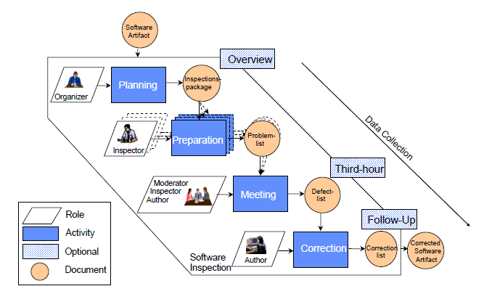
Basic Inspection Process

Slide 30
Process and participants
Planning: Deciding what to inspect, who should be involved, in what role, and if inspection is ready to start.
Overview meeting: The author meets with and gives an overview of the inspection object to the inspectors. Assignment of individual pieces among the inspectors is also done.
Preparation: Individual inspection is performed by each inspector, with attention focused on possible defects and question areas.

Slide 31
Process and participants
Inspection meeting to collect and consolidate individual inspection results. Fault identification in this meeting is carried out as a consensus building process.
Rework: The author fixes the identified problems or provides other responses.
Follow-up: Closing the inspection process by final validation.

Slide 32
Generic inspection process and Fagan inspection process
We can adapt the generic inspection program (slide 7) to depict Fagan inspection in the following:
The “planning and preparation” block can be expanded into three sequential steps, “planning”, “overview”, and “preparation” in Fagan inspection.
The “inspection/collection” is directly mapped to the “inspection” step.
The “correction and follow-up” block can be expanded into two sequential steps, “correction”, and “follow-up”.
The dotted link for the next round of inspection is eliminated.

Slide 33
General observations and findings
The importance of preparation
Variations with team size, moderator role, and session coordination
Defect detection techniques used in inspection
Additional use of inspection feedback

Slide 34
Other Inspections and Related Activities
Variations to Fagan inspection have been proposed and used to effectively conduct inspection under different environments.
Some of them are direct responses to some of the general findings of Fagan inspection described above. We organize these inspection techniques and processes along two dimensions:
size and scope of the inspection,
formality of the inspection.

